Slide 1
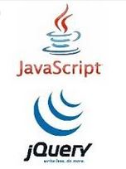
JavaScript and jQuery Course
Session 02

Slide 2
Variables
an identifier that stores some kind of data
var keyword (lowercase)
declares the variable
= (assignment operator)
assigns a value
initializes the variable

Slide 3
Variables
var myName = "Teresa";
assignment
operator
quotations
keyword
name
of variable
value
semicolon

Slide 4
Variables
var myName = "Teresa";
var theTotal = 200;
spaces do not matter around the equal sign
be consistent in how you use spaces
quotations around a literal or string
but not around a number for calculating

Slide 5
Variables – How to name
Begin with a letter, the $ character, or the underscore (_)
Cannot begin with a number, but can contain a number
Cannot contain spaces, punctuation, mathematical or logical operators
Cannot be JavaScript reserved words

Slide 6
Variables – How to name
camel-case syntax / underscore
case sensitive

Slide 7
Variables – getting started
Declare
var myName;
Initialize (assign a value)
myName = "Teresa";

Slide 8
Variables – getting started
Declare and Initialize at same time
var myName = "Teresa";

Slide 9
Declare many variables at once
var myName, myAddr, myPhone;
comma
Pro's | Only have to type var once
Con's | Can be more difficult to find the definition of a variable
If you use this technique, do not type a list that extends beyond the right-side of the editor!

Slide 10
Declare and initialize many at once
var myName = "Teresa", myAddr = "2 Main St", myPhone = "760-555-1212";
comma
Pro's | Only have to type var once
Con's | Can be more difficult to find the definition and initialization of a variable
If you use this technique, do not type a list that extends beyond the right-side of the editor!

Slide 11
Variable types

Slide 12
Variables
Scope Variables exist where they are created
Global Variables - declared outside of a function
Can be used inside or outside of functions
Local Variables - declared inside a function
Can only be used in that function

Slide 13
Arithmetic Operators
+ | Addition | var a = 2 + 4;
- | Subtraction | var s = 6 - 2;
* | Multiplication | var m = 5 * 3;
/ | Division | var d = 5 / 3;
% | Modulus (remainder) | var r = 43 % 10; (result: 3)

Slide 14
Arithmetic Operators
Unary operators - means "only one factor"
++ Increment (adds one to the value) -- Decrement (subtracts one from the value)
Examples
x++
n--

Slide 15
Shorthand Operators
Operator | Example | Equivalent to
= | y = x + 3;
+= | x += 3; | x = x + 3;
-= | x -= 3; | x = x - 3;
*= | x *= 3; | x = x * 3;
/= | x /= 3; | x = x / 3;

Slide 16
Order of Precedence

Slide 17
Concatenation
Concatenate = Join
+ sign
will add numbers
will concatenate strings

Slide 18
Concatenation
var n = 1 + 1; | // n is 2
var f = 3 + "fido"; | // f is "3fido"
var ff1 = "fire" + "fox"; | // ff1 is "firefox"
var ff2 = "fire" + " " + "fox"; | // ff2 is "fire fox"

Slide 19
Type Conversions
parseInt() function
parses a string/number and returns an integer
parseFloat() function
parses a string/number and returns a floating point number (decmial) toString() method
converts a number to a string

Slide 20
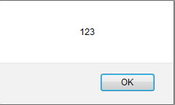
Type Conversion
parseInt() function
parses and returns an integer (whole number)
Example
var num = 123.4567;
num = parseInt(num);
alert(num);

Slide 21
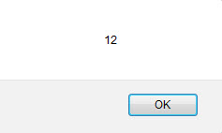
Type Conversion
toString() method
converts a number to a string
Example
var num1 = 1;
num1 = num1.toString();
var num2 = 2;
num2 = num2.toString();
alert(num1 + num2);

Slide 22
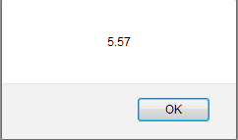
Formatting Numbers
Do this last!
It is formatting
.toFixed() method of the number object
number object is part of the JavaScript language
Converts a number into a string, keeping the number of decimals specified in parentheses Example
var num = 5.56789;
num = num.toFixed(2);
alert(num);

Slide 23
Testing a Variable
Firebug Add-on for Firefox
console.log(variable_or_expression);
Editor / Browser – How to Write code
alert(variable_or_expression);
alert("the result is: " + variable);

Slide 24
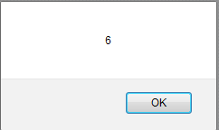
Math Object
Math object is part of the JavaScript language uppercase "M"
Math.ceil() – rounds upward to the nearest integer
Example
var num = 5.56789;
num = Math.ceil(num);
alert(num);

Slide 25
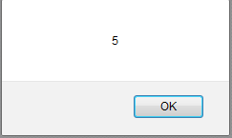
Math Object
Math.floor()
rounds downward to the nearest integer
Example
var num = 5.56789;
num = Math.floor(num);
alert(num);

Slide 26
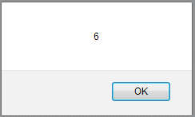
Math Object
Math.round()
rounds to the nearest integer can be up or down, whichever is closest
Example
var num = 5.56789;
num = Math.round(num);
alert(num);

Slide 27
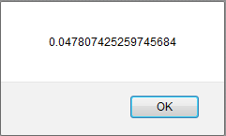
Math Object
Math.random()
generates a random decimal number
between 0 and 1 but not including 1
Example
var num = Math.random();
alert(num);

Slide 28

Math Object
Math.floor() and Math.random()
generate a whole number within a range
Example
var num = Math.floor(Math.random() * 11);
alert(num);

Slide 29
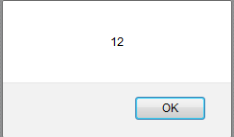
String Object
length property
returns the length of a string
Example
var myString = "Hello World!";
alert(myString.length);

Slide 30
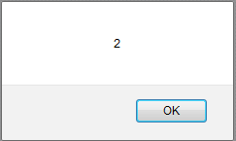
String Object
indexOf()
returns the position of the first occurrence of a specified value – begins at 0
Example
var myString = "Hello World!";
alert( myString.indexOf("l") );

Slide 31
String Object
lastIndexOf()
returns the position of the last occurrence of a specified value
charAt()
returns the character at the specified index

Slide 32
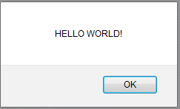
String Object
toLowerCase()
converts a string to lowercase letters
toUpperCase()
converts a string to uppercase letters
Example
var myString = "Hello World!";
alert( myString.toUpperCase() );

Slide 33
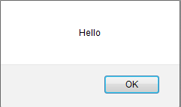
String Object
slice()
extracts a part of a string and returns a substring
takes the starting and ending position, or just the start position (will go to the end of string)
Example
var myString = "Hello World!";
alert( myString.slice(0,5) );

Slide 34
Escape Characters
Example
alert("Hello \"Big\" World!");
Displays: Hello "Big" World!

Slide 35
Alternating Quotations
Example
alert( 'Hello "Big" World!' );
Displays: Hello "Big" World!

